Slide 1
Asymmetric Cryptography
Paul Dubois
for
info@lèze

Slide 2
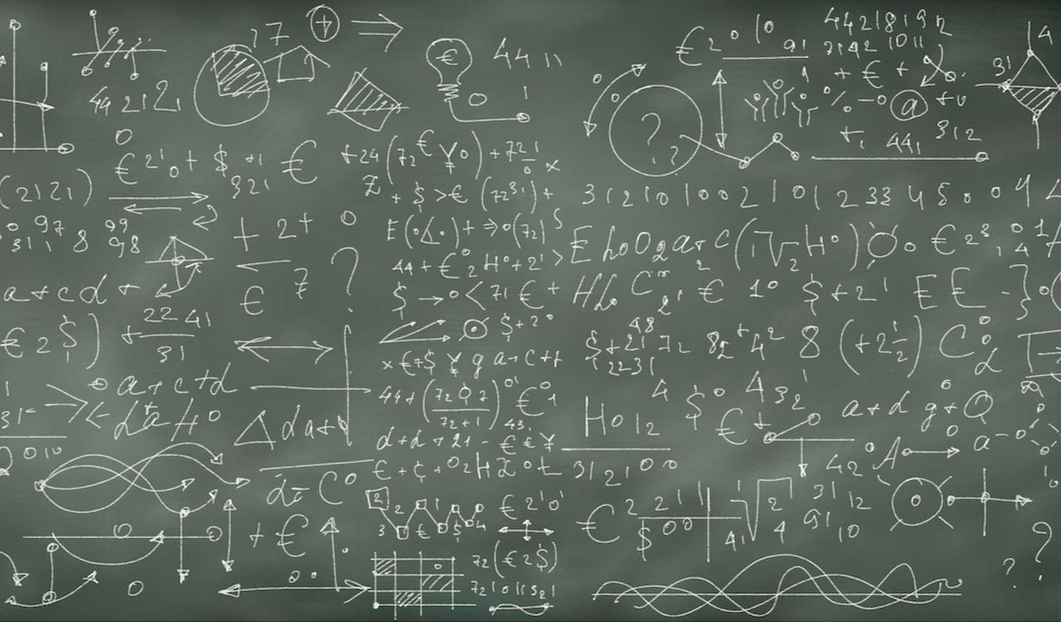
Do you like equations?

Slide 3
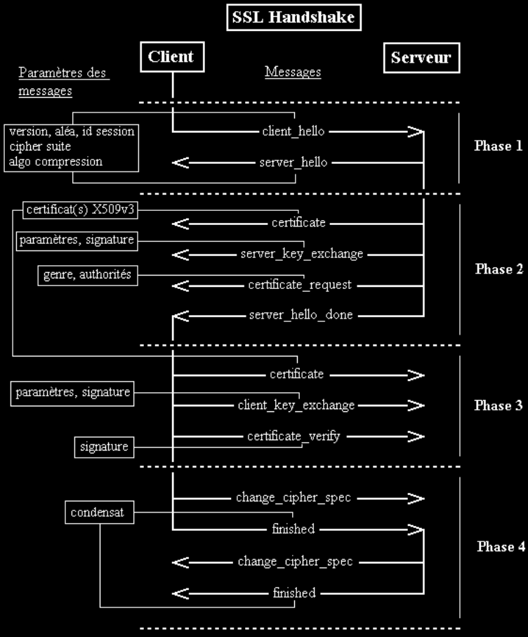
Do you like security protocols?

Slide 4
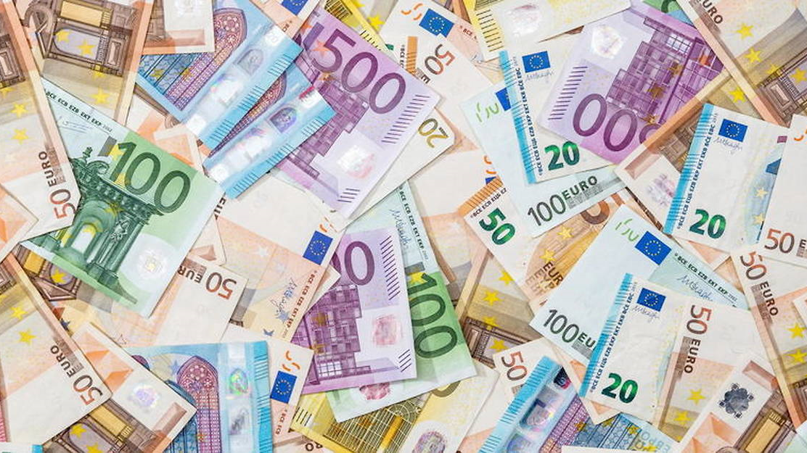
Do you like money?

Slide 5
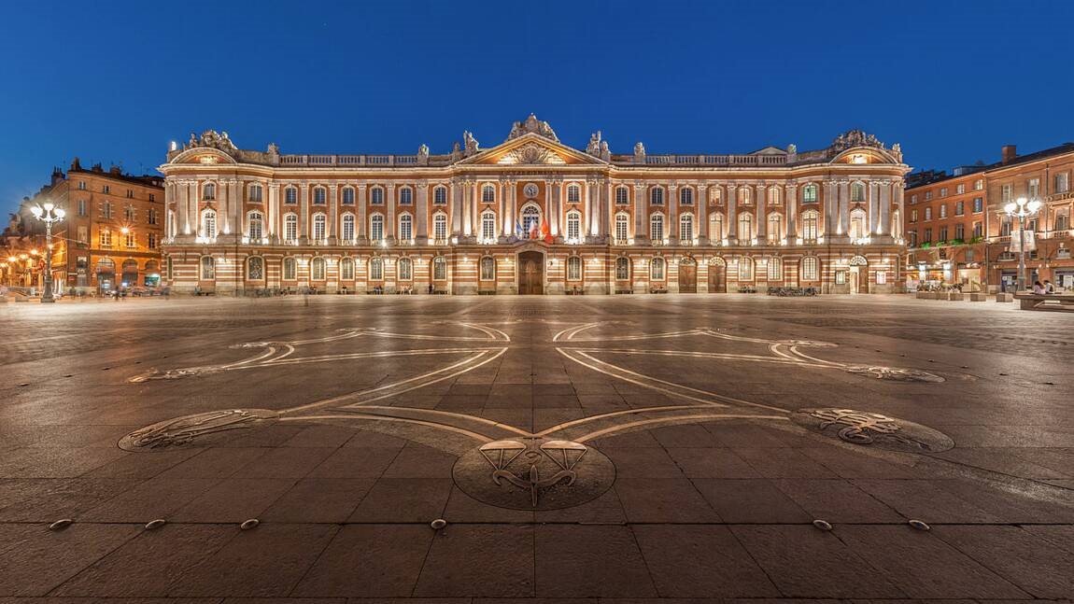
Do you like Toulouse?

Slide 6

How to send a secret… … with a speaker?

Slide 7
3 RSA
2 Encoding
1 Alice & Bob

Slide 8
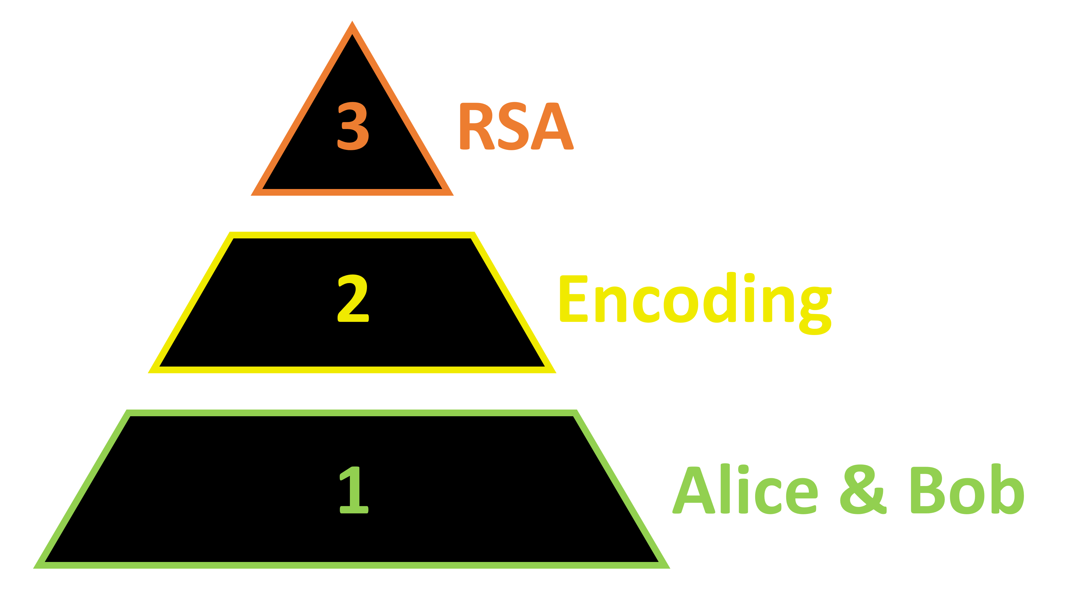


5 Elliptic Curves
4 ElGamal
2nd Part
1st Part

Slide 9
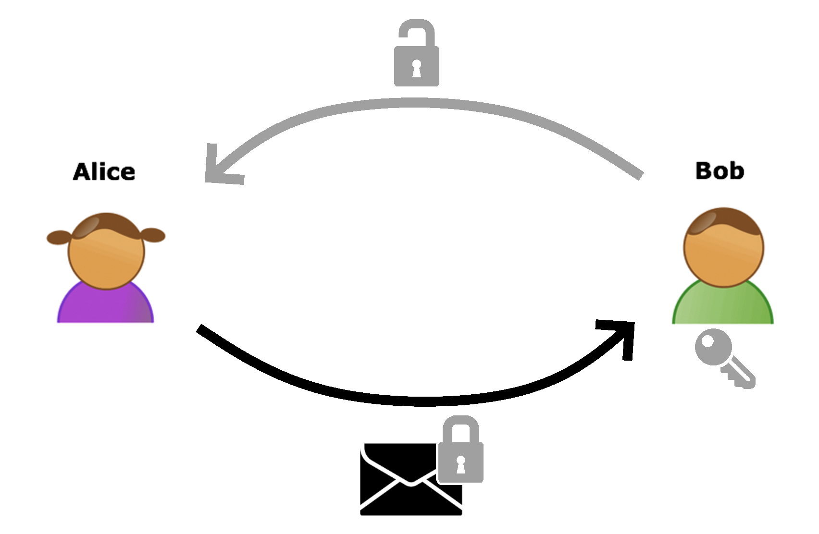
Level 1
Lock Analogy

Slide 10



Send a message without a secured connection
Alice Groupe
Bob Groupe

Slide 11


Slide 12


Send a message without a secured connection: Intuition
Alice Groupe
Bob Groupe
?
Notes:
1ere intuition: fausse

Slide 13
Send a message without a secured connection: Reality
Alice Groupe
Bob Groupe
✓
Notes:
1ere intuition: réalité

Slide 14


Send a message without a secured connection: Solution
Alice Groupe
Bob Groupe
?
Notes:
Solution

Slide 15

Send a message without a secured connection: Synthesis

Slide 16
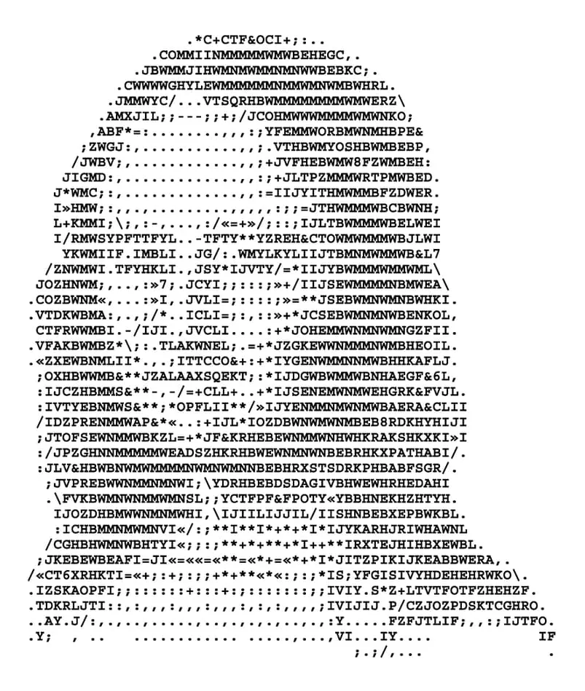
Level 2
Encoding of a message numerically
Non-contractual image

Slide 17
Coding a message
Alice Groupe
Bob Groupe
Code: ???
Code: xxx
Code: xxx

Slide 18
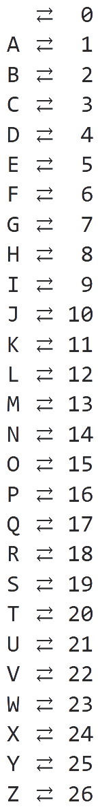
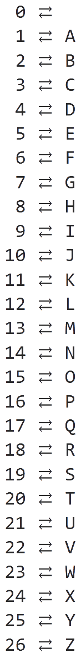
"blah"
2,12,1,8
+ xx [27]
5,15,4,11
"eodk"

Slide 19

Representation of the encoding system
(addition)
https://pauldubois98.github.io/AsymmetricCryptographyTalk/tools/code_add.html

Slide 21
"blah"
2,12,1,8
× xx [27]
4,24,2,16
"dxbp"

Slide 22

Representation of the encoding system
(multiplication)
https://pauldubois98.github.io/AsymmetricCryptographyTalk/tools/code_mult.html

Slide 23
Principals conclusions
Representation of the alphabet by numbers
Modulo arithmetic so that the range of number used do not explode
Coding with multiplication more complex than with addition
Encryption is symmetric
« + » :
Low costs in terms of computations
« - » :
Need a code key that the spy doesn’t know

Slide 24
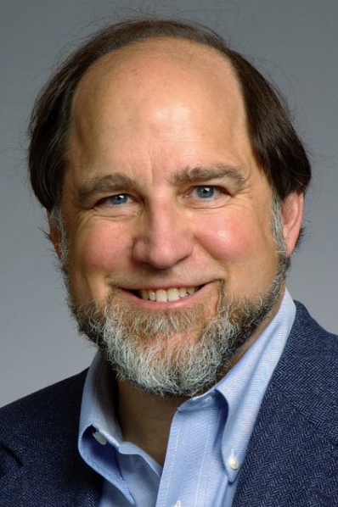
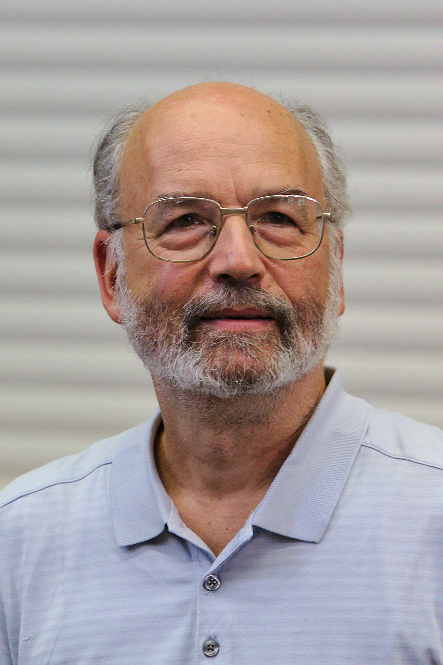
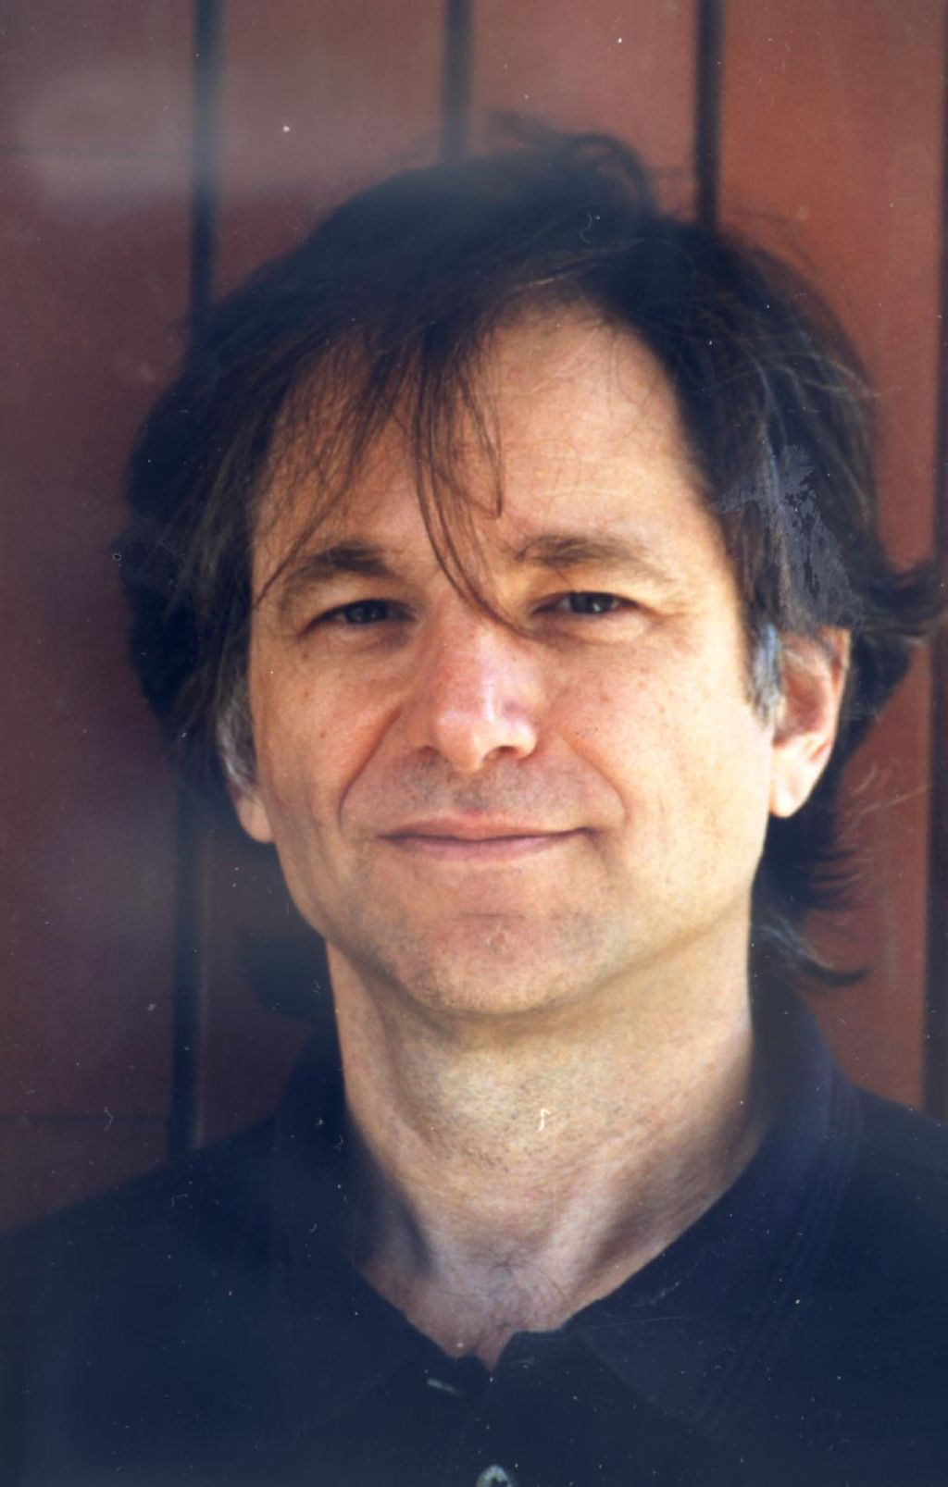
Level 3
Ronald Rivest
Adi Shamir
Leonard Adleman
RSA Encryption

Slide 25
What’s a prime number?
« a number that we cannot factorize »
6
=2*3
7
=??
=1*7
=2*3,5
Trivial !
11
12
35

Slide 26
Communication via a spy (without private key)

Slide 27
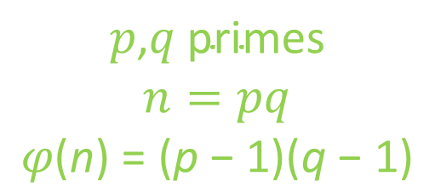
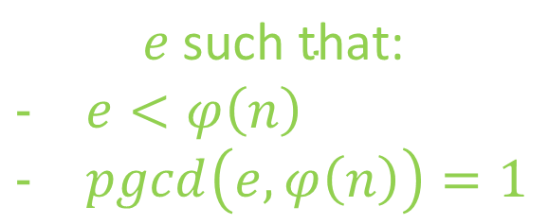
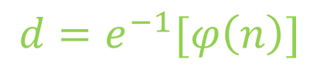

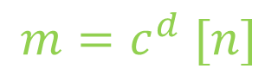

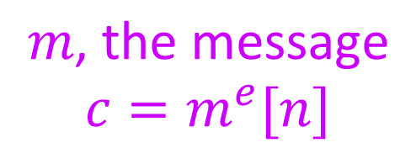
$$p\text{,}q \text{primes}$$
$$n=pq$$
$$φ\text{(}\text{n}\text{) = (}\text{p}\text{ − 1)(}\text{q}\text{ − 1)}$$
$$\left(n,e\right)$$
$$m\text{, }\text{the} \text{message}$$
$$c=m^{e}[n]$$
$$e \text{such} \text{that}\text{:}$$
$e<φ\left(n\right)$
$pgcd\left(e,φ\left(n\right)\right)=1$
$$c$$
$$d=e^{−1}[φ\left(n\right)]$$
$$m=c^{d} [n]$$
« Fermat’s theorem »

Slide 28
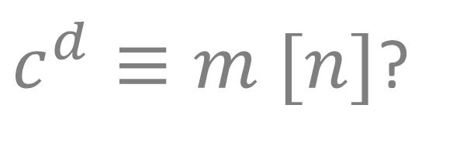
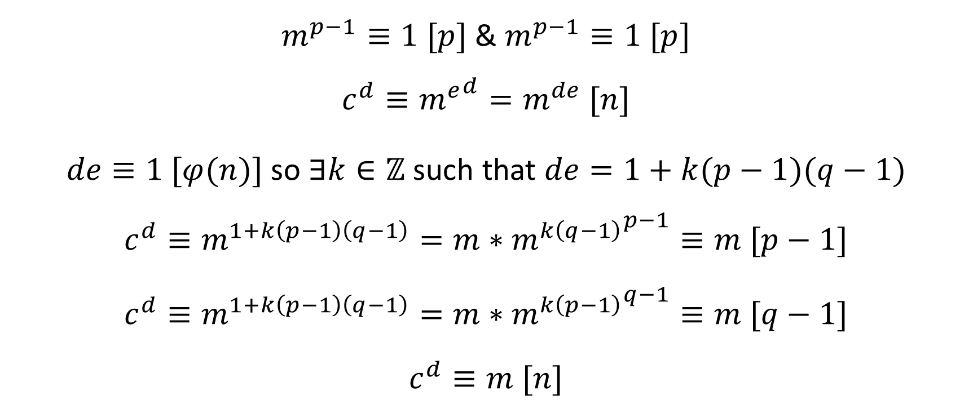
RSA: Why does t work?
$c^{d}≡m [n]$?
$m^{p−1}≡1 [p]$ & $m^{p−1}≡1 [p]$
$$c^{d}≡{m^{e}}^{d}=m^{de} [n]$$
$de≡1 [φ(n)]$ so $∃k∈ℤ$ such that $de=1+k(p−1)(q−1)$
$$c^{d}≡m^{1+k\left(p−1\right)\left(q−1\right)}=m∗{m^{k\left(q−1\right)}}^{p−1}≡m [p−1]$$
$$c^{d}≡m^{1+k\left(p−1\right)\left(q−1\right)}=m∗{m^{k\left(p−1\right)}}^{q−1}≡m [q−1]$$
$$c^{d}≡m [n]$$

Slide 29

RSA Helper
https://pauldubois98.github.io/AsymmetricCryptographyTalk/tools/rsa_helper.html

Slide 31
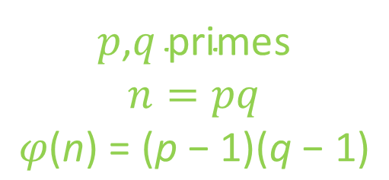
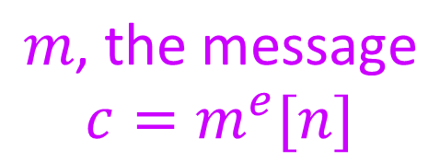
$p\text{,}q \text{prime}$s
$$n=pq$$
$$φ\text{(}\text{n}\text{) = (}\text{p}\text{ − 1)(}\text{q}\text{ − 1)}$$
$$\left(n,e\right)$$
$$m\text{, }\text{the} \text{message}$$
$$c=m^{e}[n]$$
$$e \text{such} \text{that}\text{:}$$
$e<φ\left(n\right)$
$pgcd\left(e,φ\left(n\right)\right)=1$
$$c$$
$$d=e^{−1}[φ\left(n\right)]$$
$$m=c^{d} [n]$$

Slide 32
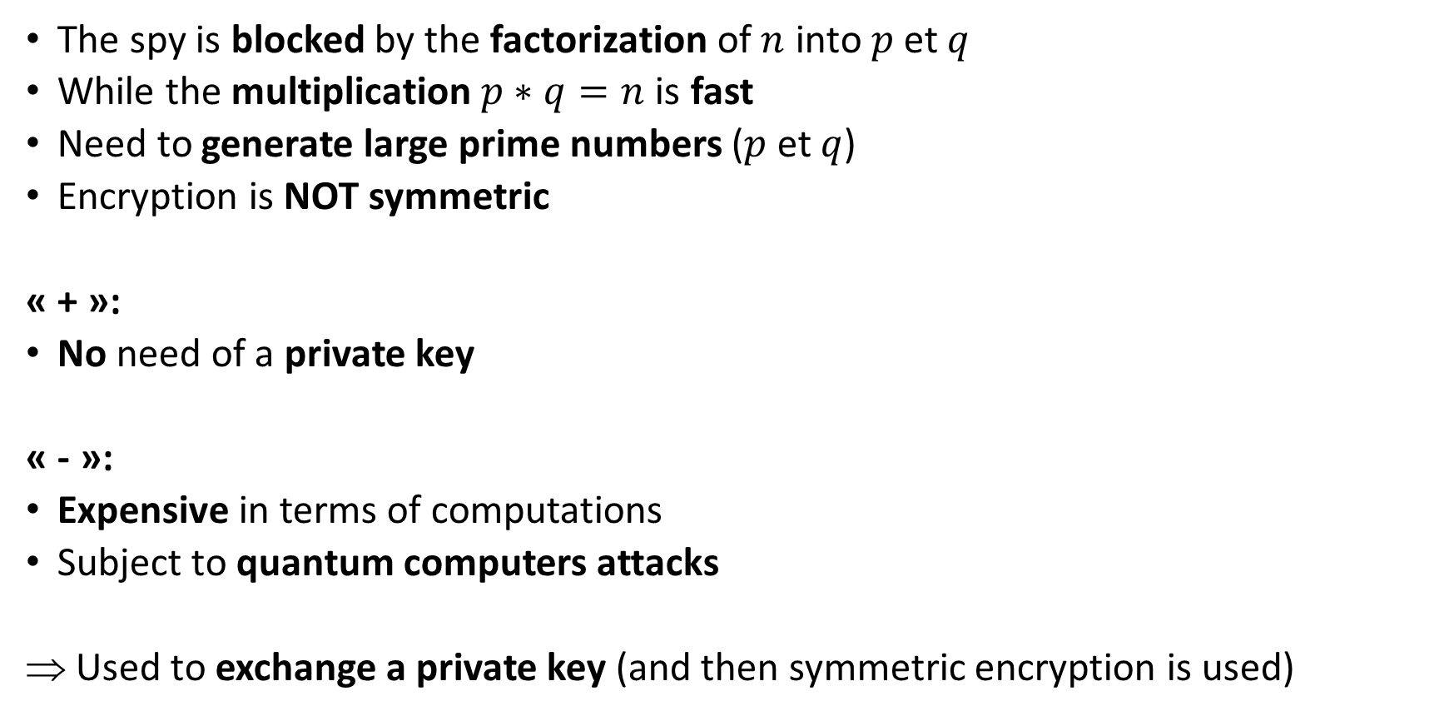
Principals conclusions
The spy is blocked by the factorization of $n$ into $p$ et $q$
While the multiplication $p∗q=n$ is fast
Need to generate large prime numbers ($p$ et $q$)
Encryption is NOT symmetric
« + »:
No need of a private key
« - »:
Expensive in terms of computations
Subject to quantum computers attacks
Used to exchange a private key (and then symmetric encryption is used)

Slide 33
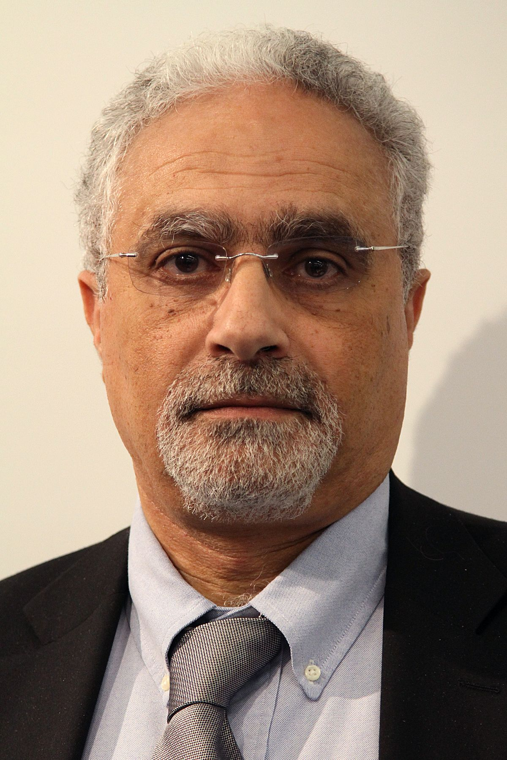
Level 4
ElGamal Encryption
ElGamal

Slide 34


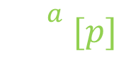
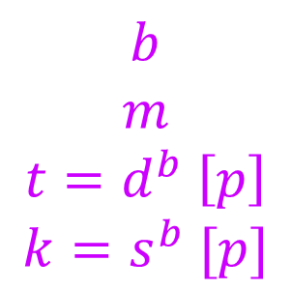

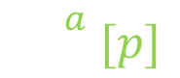
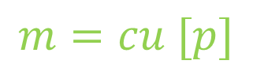
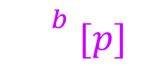
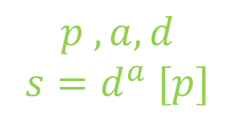


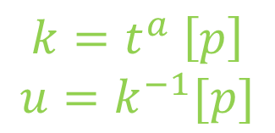
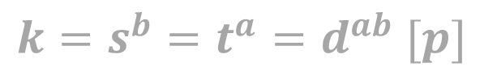


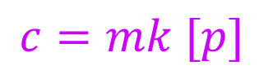
$$t$$
$$c$$
$$k=s^{b}=t^{a}=d^{ab} [p]$$
$$d$$
$$s$$
$${}^{a} [p]$$
$${}^{b} [p]$$
$${t=d}^{b} [p]$$
$${s=d}^{a} [p]$$
$${}^{b} [p]$$
$${}^{a} [p]$$
$$d [p]$$
$$p$$
$$b$$
$$m$$
$$t=d^{b} \left[p\right]$$
$$k=s^{b} [p]$$
$$p ,a,d$$
$$s=d^{a} [p]$$
$$k=t^{a} \left[p\right]$$
$$u=k^{−1}[p]$$
$$c=mk [p]$$
$$m=cu [p]$$

Slide 35
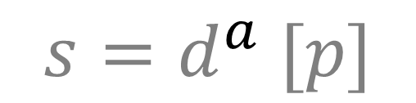
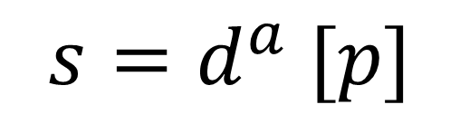
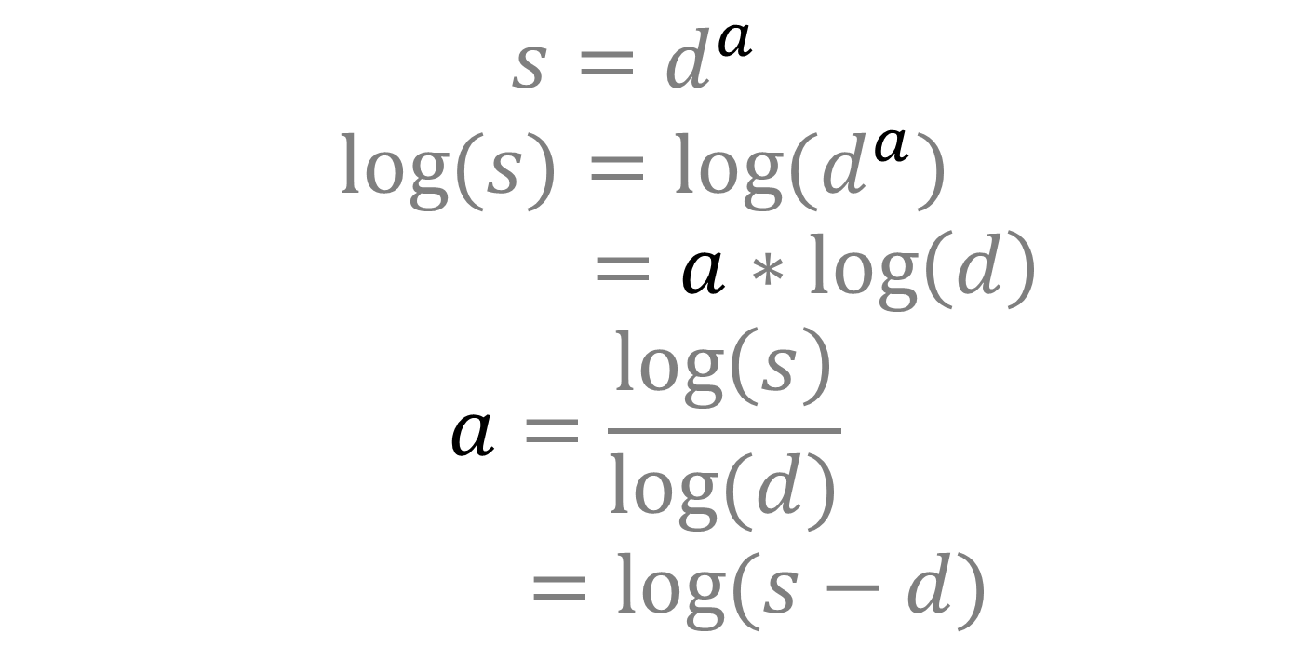
Modulo Logarithm
$${s=d}^{a} [p]$$
$${s=d}^{a} [p]$$
${s=d}^{a}$
$${log⁡(s)=log⁡(d}^{a})$$
$=a∗\log\left(d\right)$
$$a=\frac{\log\left(s\right)}{log⁡(d)}$$
$=log⁡(s−d)$

Slide 36

Modulo Calculator
https://pauldubois98.github.io/AsymmetricCryptographyTalk/tools/mod_calculator.html

Slide 38
$$t$$
$$c$$
$$k=s^{b}=t^{a}=d^{ab} [p]$$
$$d$$
$$s$$
$${}^{a} [p]$$
$${}^{b} [p]$$
$${t=d}^{b} [p]$$
$${s=d}^{a} [p]$$
$${}^{b} [p]$$
$${}^{a} [p]$$
$$d [p]$$
$$p$$
$$b$$
$$m$$
$$t=d^{b} \left[p\right]$$
$$k=s^{b} [p]$$
$$p ,a,d$$
$$s=d^{a} [p]$$
$$k=t^{a} \left[p\right]$$
$$u=k^{−1}[p]$$
$$c=mk [p]$$
$$m=cu [p]$$

Slide 39
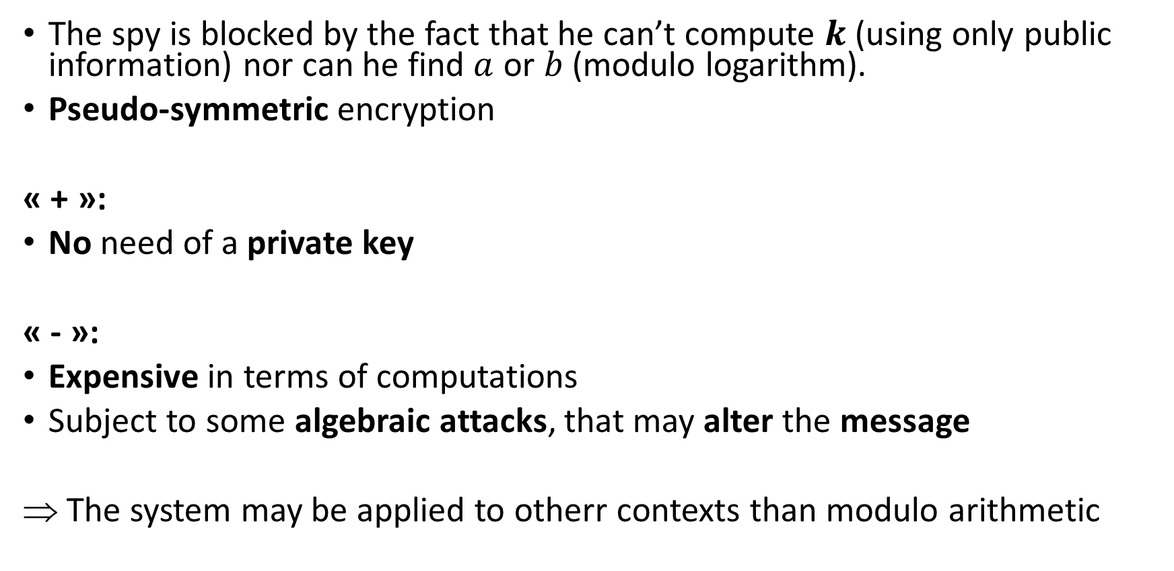
Principals conclusions
The spy is blocked by the fact that he can’t compute $k$ (using only public information) nor can he find $a$ or $b$ (modulo logarithm).
Pseudo-symmetric encryption
« + »:
No need of a private key
« - »:
Expensive in terms of computations
Subject to some algebraic attacks, that may alter the message
The system may be applied to otherr contexts than modulo arithmetic

Slide 40
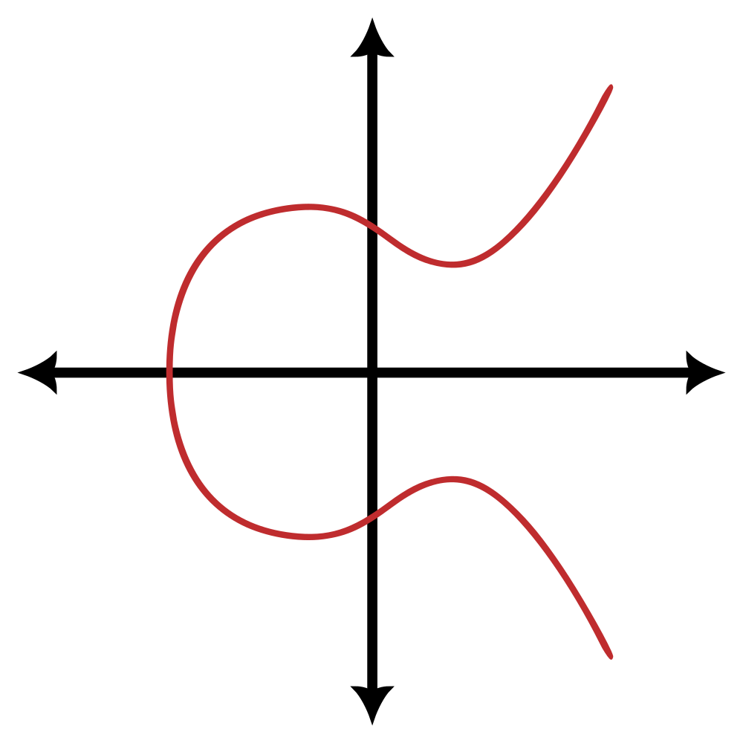
Level 5
Elliptic Curves Cryptography

Slide 41
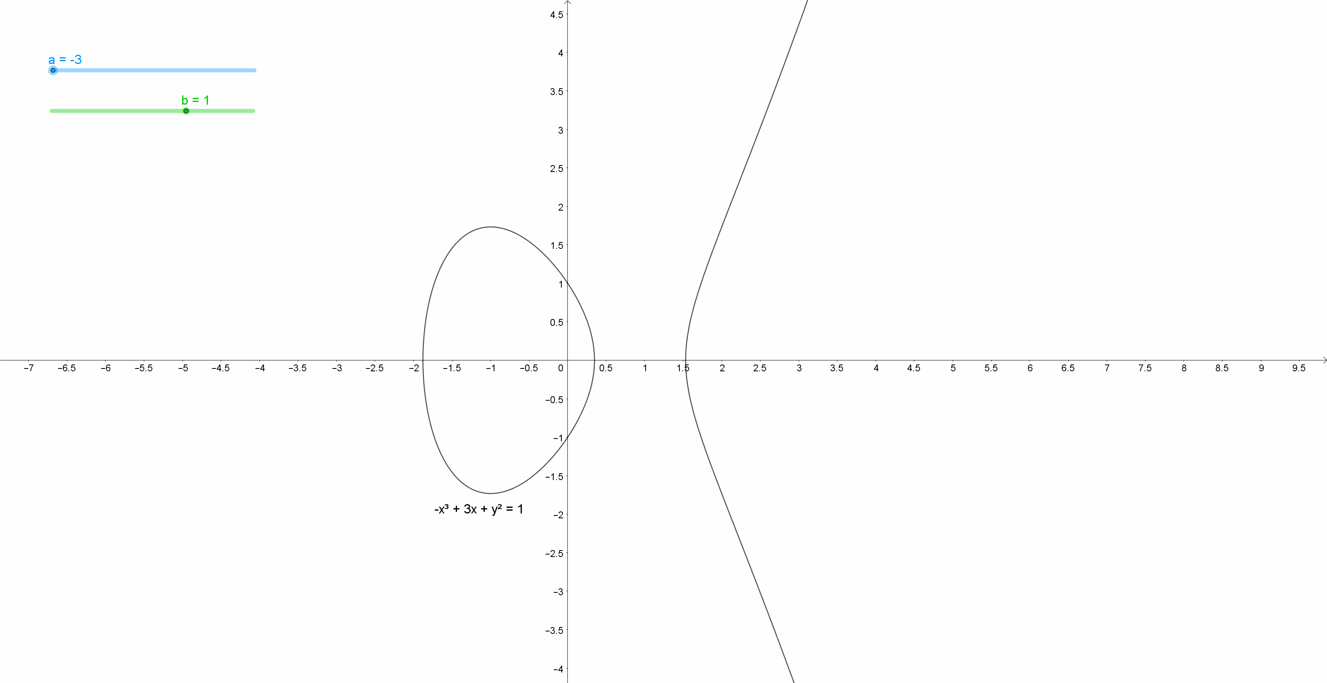
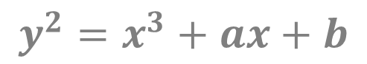
What’s an Elliptic Curve?
$$y^{2}=x^{3}+ax+b$$

Slide 42
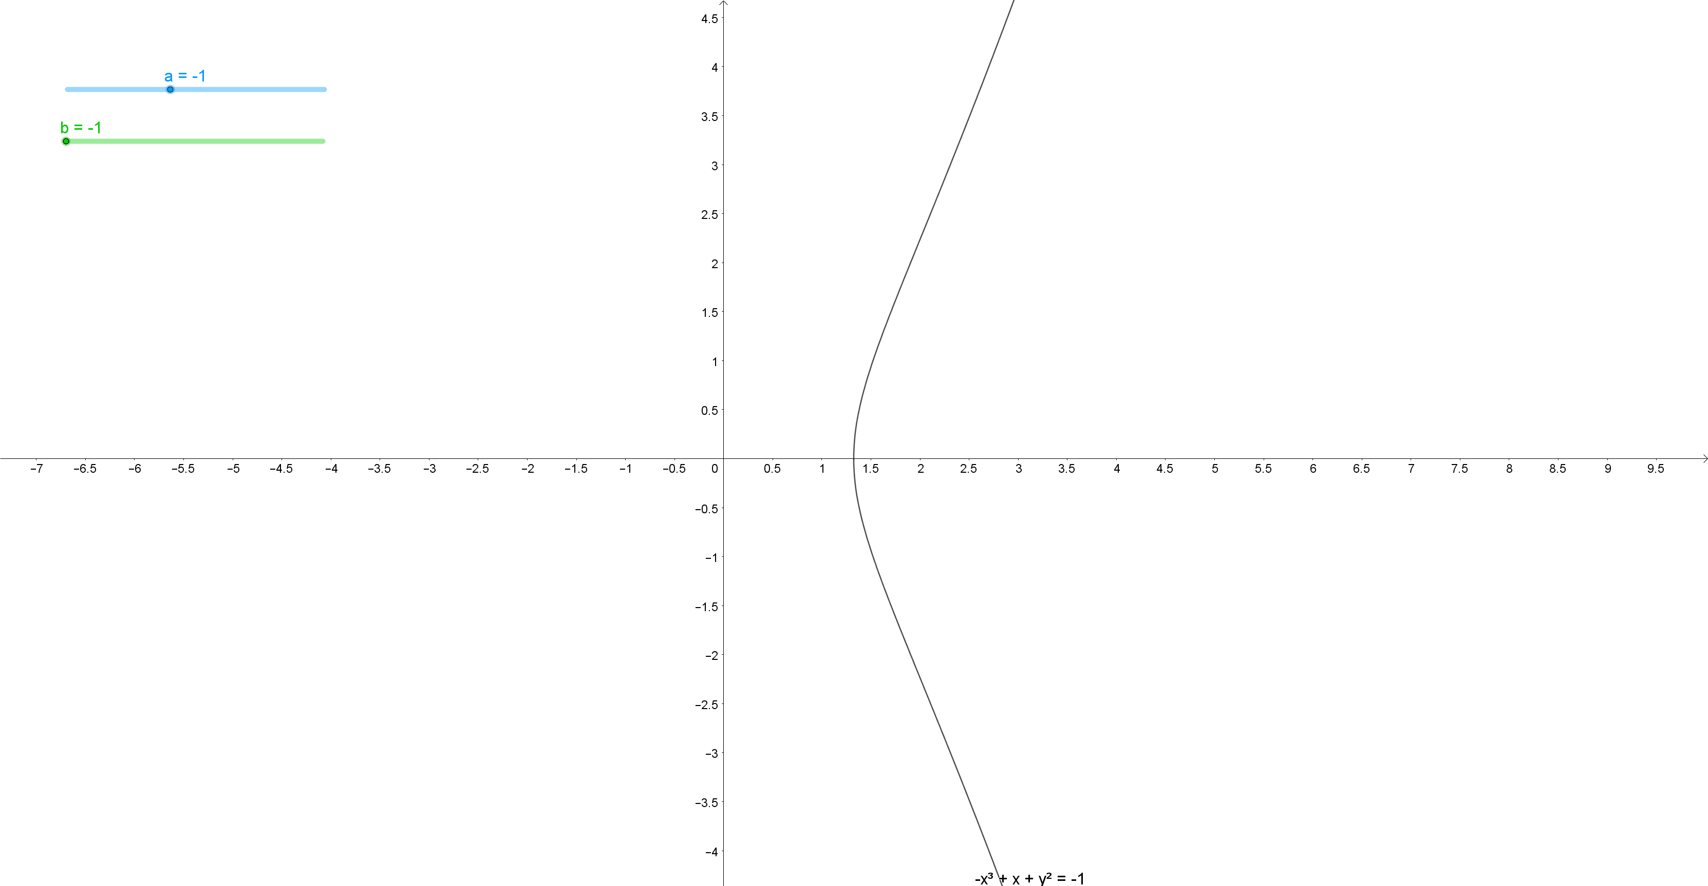
What’s an Elliptic Curve?
$$y^{2}=x^{3}+ax+b$$

Slide 43

What’s an Elliptic Curve?
$$y^{2}=x^{3}+ax+b$$
https://pauldubois98.github.io/AsymmetricCryptographyTalk/tools/elliptic_curve.html

Slide 44
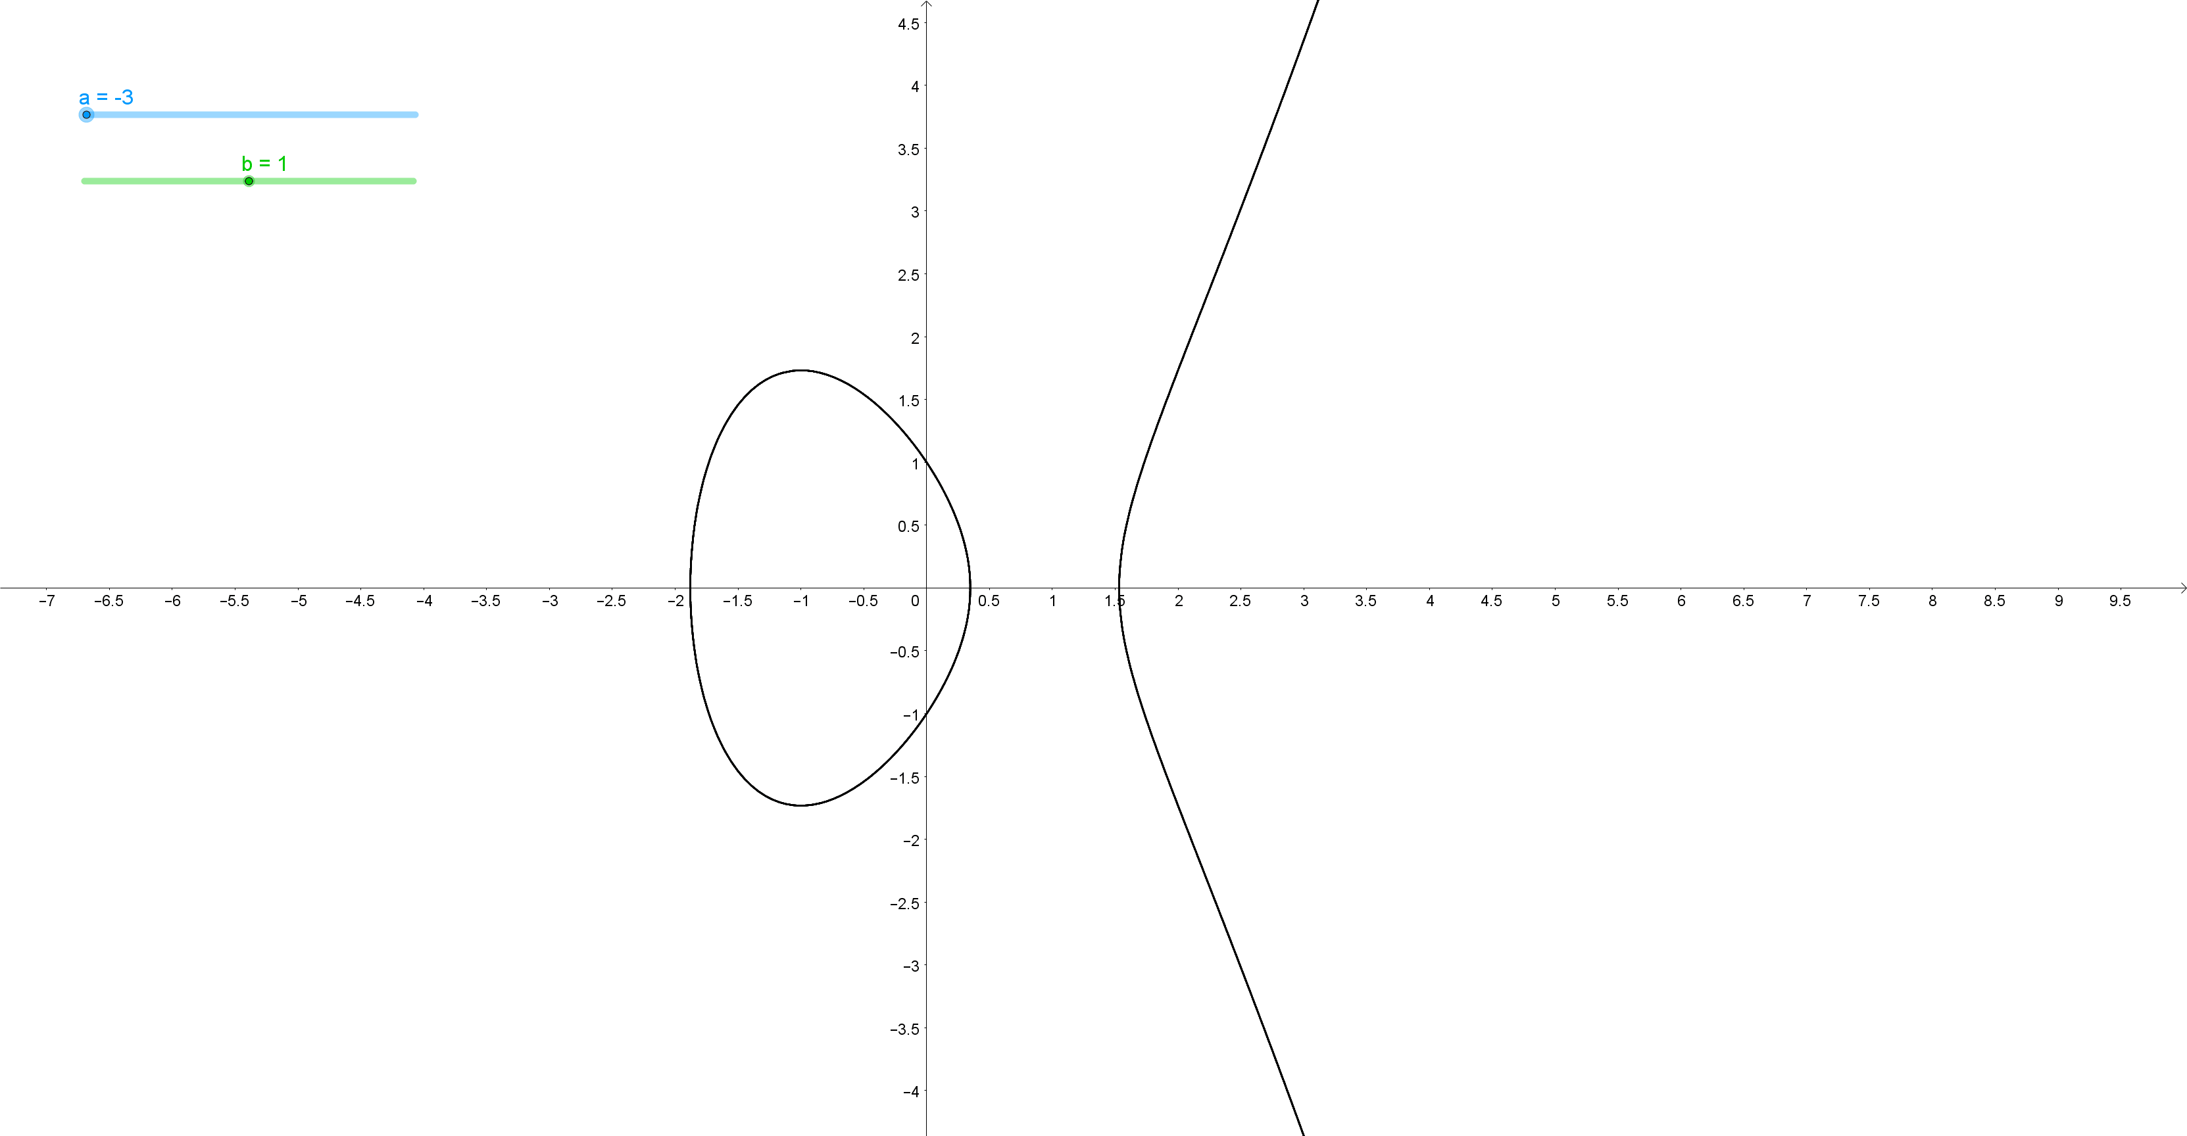
What’s an Elliptic Curve?
$$y^{2}=x^{3}+ax+b$$

Slide 45
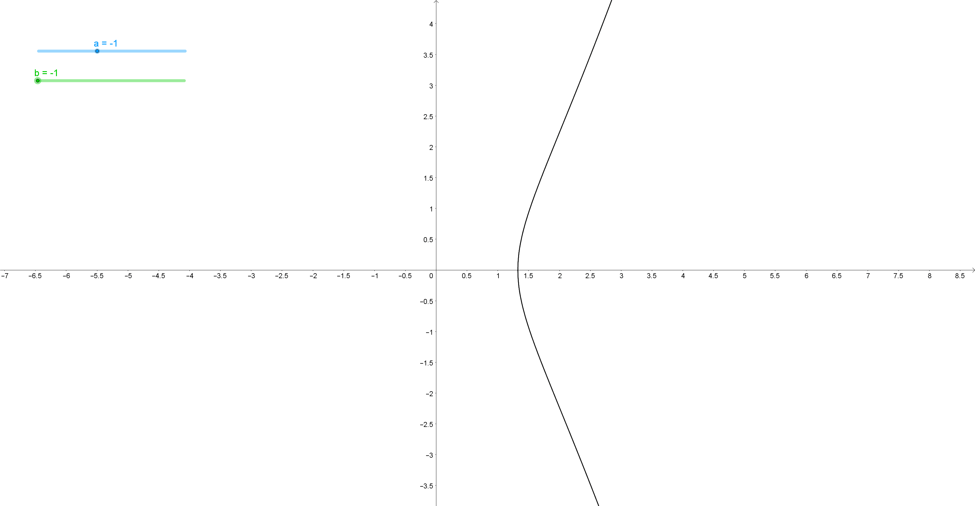
What’s an Elliptic Curve?
$$y^{2}=x^{3}+ax+b$$

Slide 46
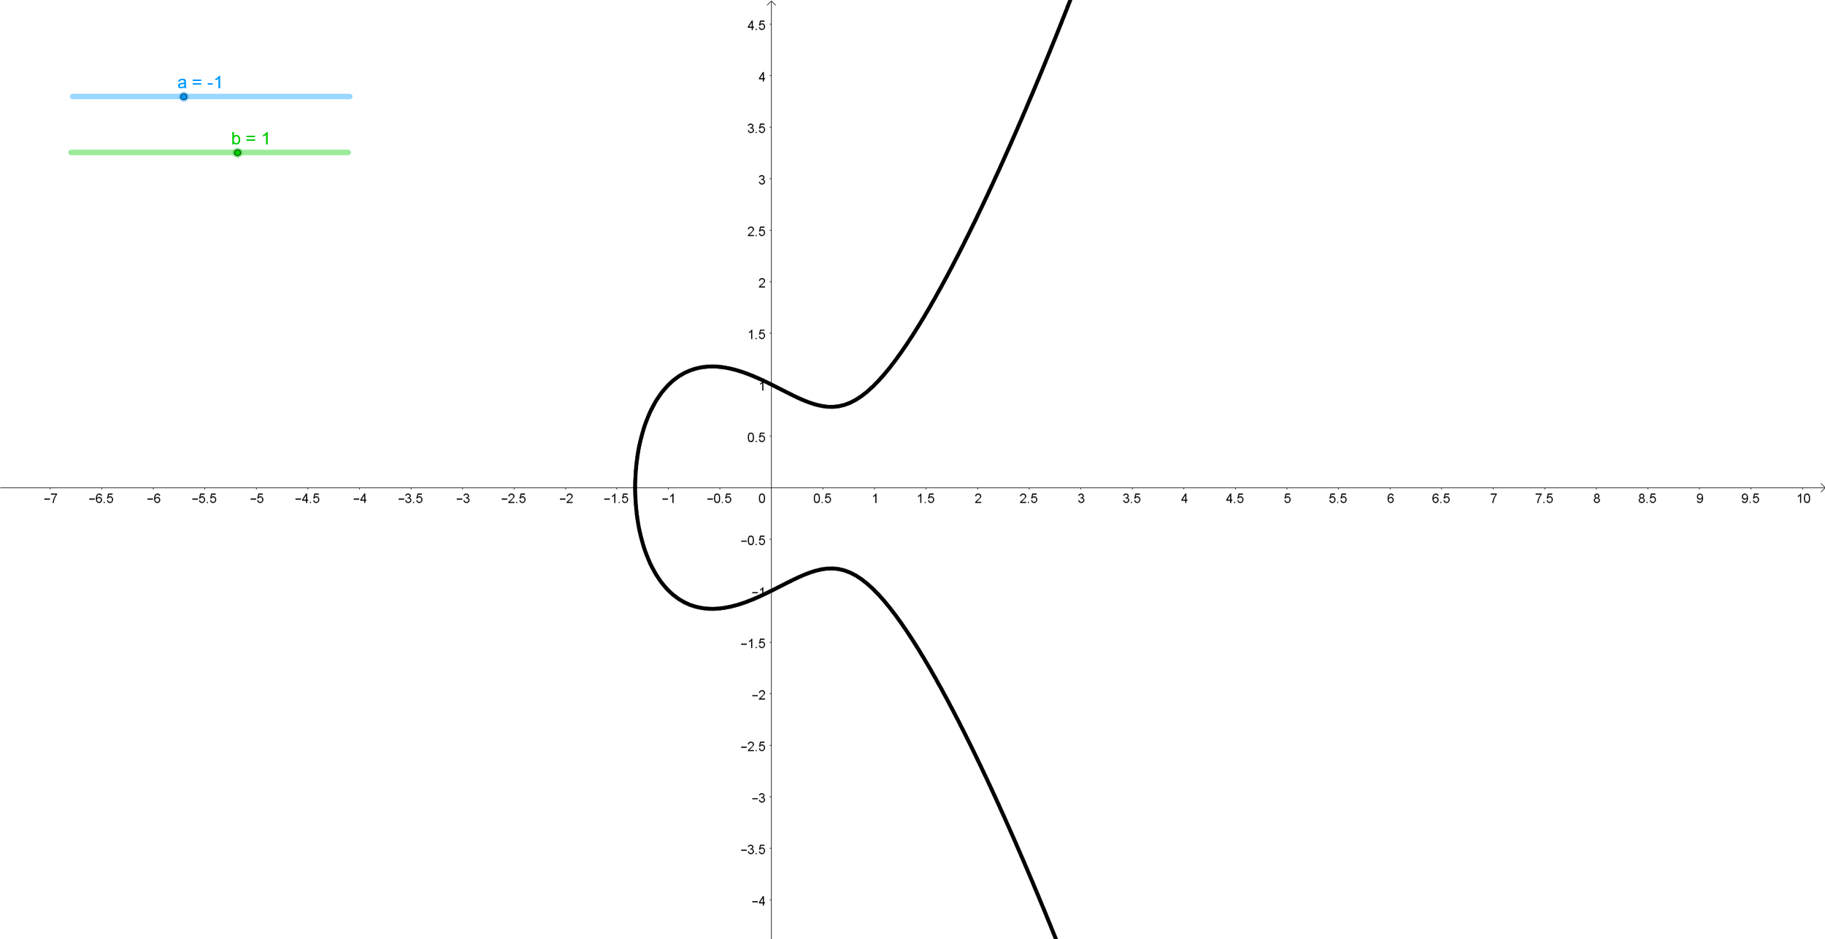
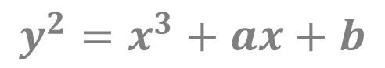
Elliptic Curve: Addition (P+Q)
$$y^{2}=x^{3}+ax+b$$
R = P✳Q
Q
P
S = P+Q
(PQ)

Slide 47
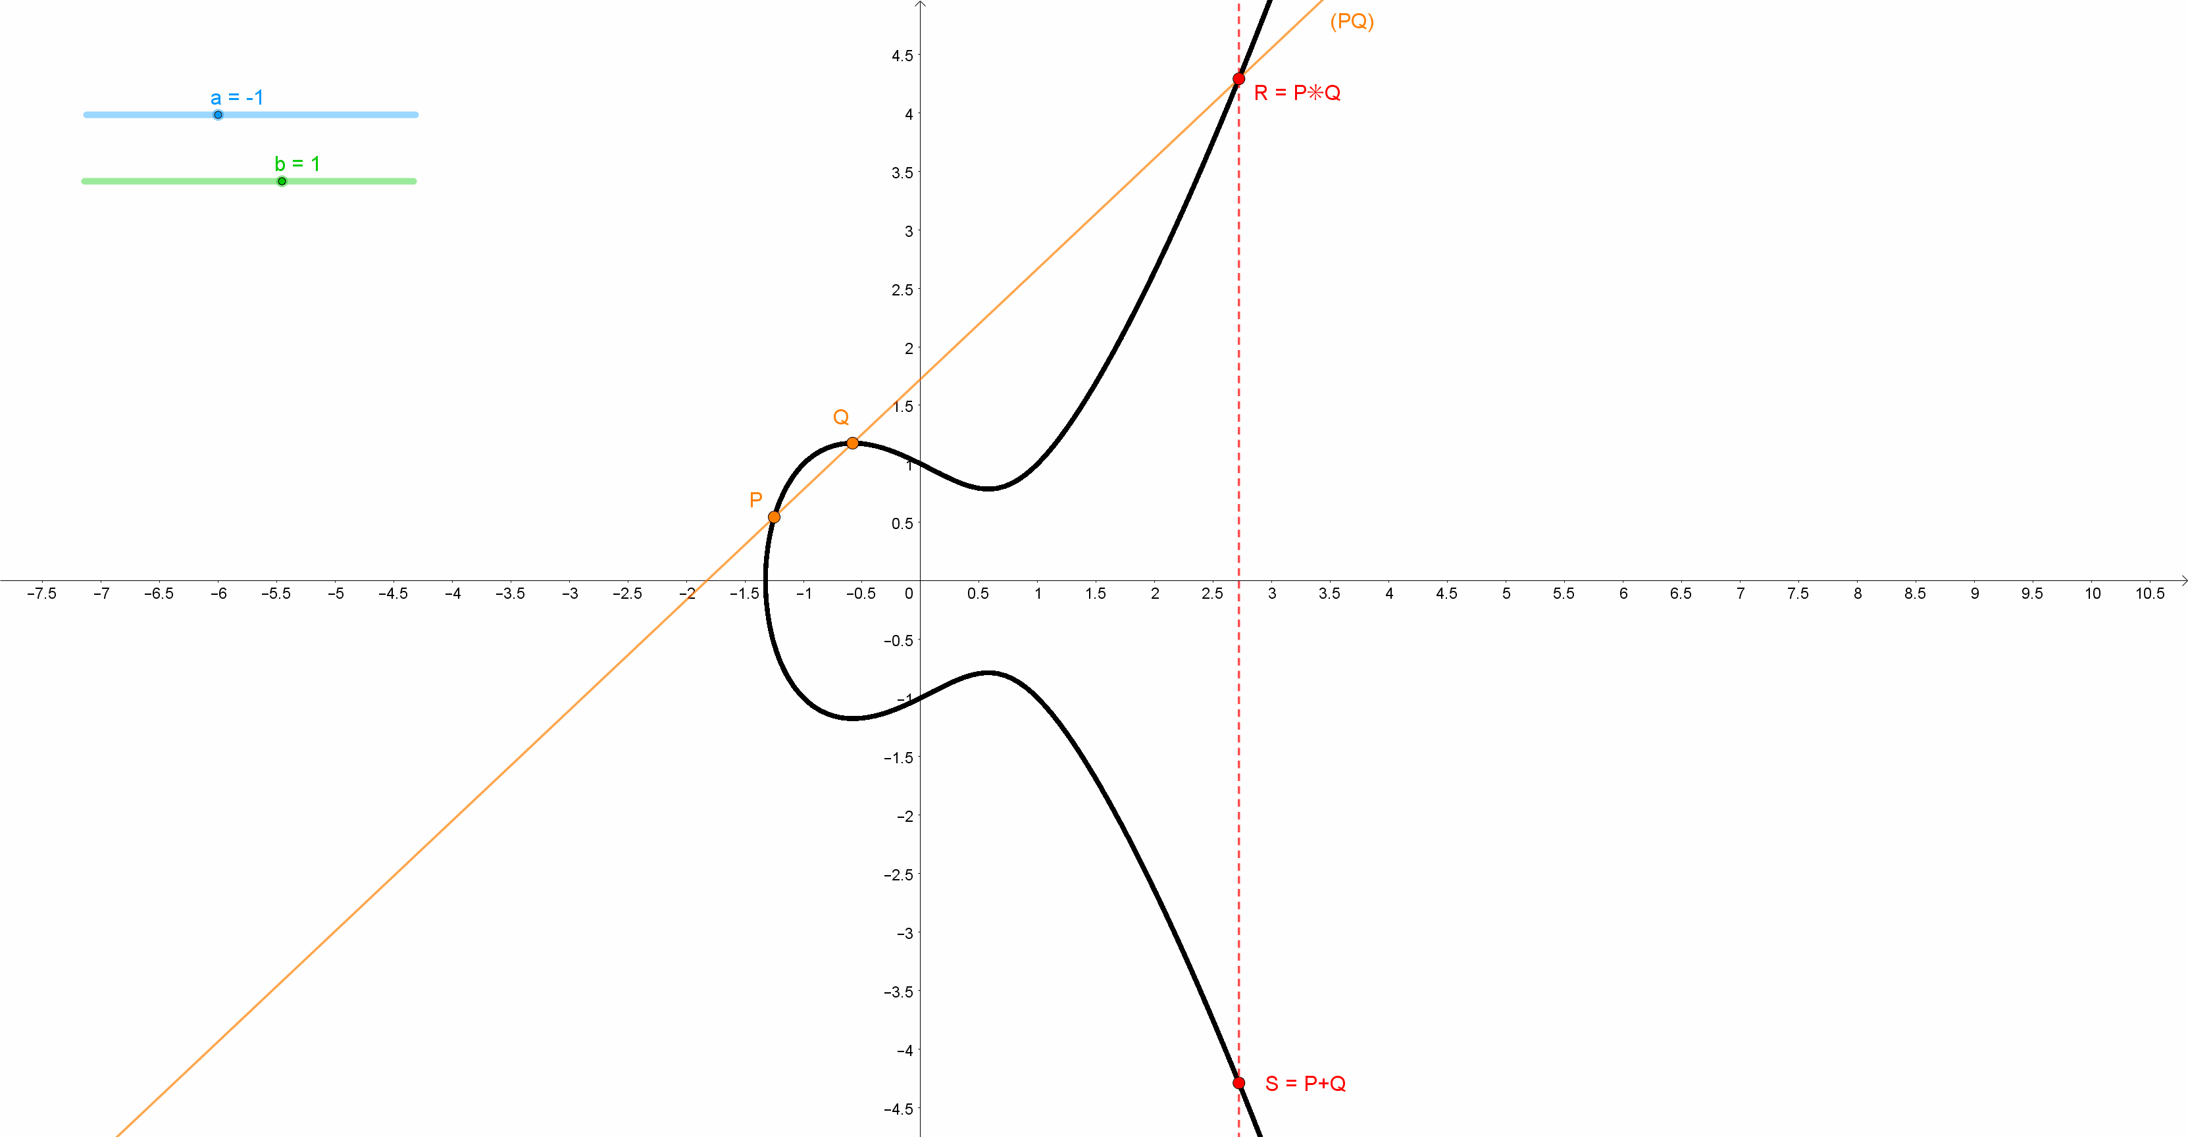
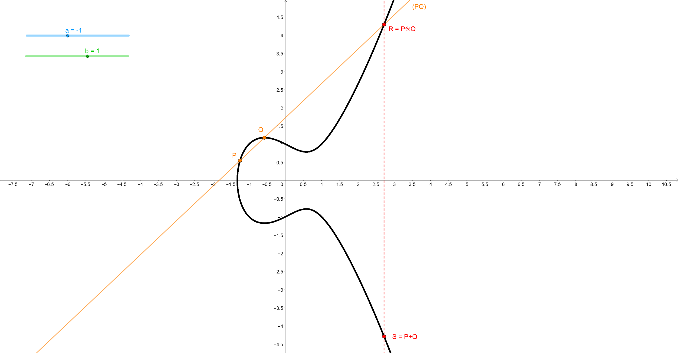
Elliptic Curve: Addition P+P?
$$y^{2}=x^{3}+ax+b$$

Slide 48
Elliptic Curve: Double (2P)
tangent
$$y^{2}=x^{3}+ax+b$$
R = P✳P
P
(tangent at P)
S = P+P = 2P

Slide 49
Elliptic Curve: 3P = P+2P
$$y^{2}=x^{3}+ax+b$$
(P-2P)
P
P+2P = 3P
P✳2P
2P

Slide 50
Elliptic Curve: 4P = 2(2P) or P+3P?
$$y^{2}=x^{3}+ax+b$$
(tangent at 2P)
P
3P
2(2P) = 4P
2P

Slide 51
Elliptic Curve: 4P = 2(2P) or P+3P?
$$y^{2}=x^{3}+ax+b$$
(P-3P)
P
3P
P+3P = 4P
4P = 2(2P)
2P

Slide 52


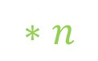
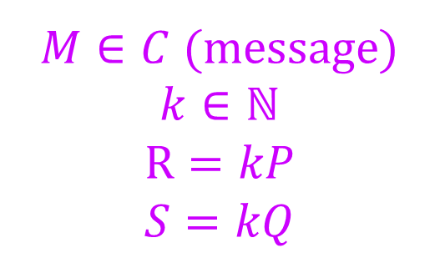

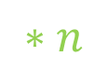

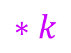








$$R$$
$$T$$
$$S=nR=kQ=nkP$$
$$P$$
$$Q$$
$$∗n$$
$$∗k$$
$$R=kP$$
$$Q=nP$$
$$∗k$$
$$∗n$$
$$P$$
$${C: y}^{2}=x^{3}+ax+b$$
$M∈C$ (message)
$$k∈ℕ$$
$$R=kP$$
$$S=kQ$$
$$n∈ℕ,P∈C$$
$$Q=nP$$
$$S=nR$$
$$T=S+M$$
$$M=T−S$$

Slide 53


Division on Elliptic Curve
$$nP=Q$$
$$n=\frac{P}{Q}$$

Slide 54

Principals conclusions
The spy is blocked by the fact that he can’t compute $S$ (using only public information) nor can he find $n$ or $k$ (division on elliptic curves).
Pseudo-symmetric encryption
« + »:
No need of a private key
« - »:
Expensive in terms of computations
(Very) Difficult to hack via brute force method
Subject to quantum computers attacks

Slide 55
Do you like money?
Do you like security protocols?
Do you like equations?
Do you like Toulouse?

Slide 56

?

Slide 57


Fermat…
was from Toulouse!
« Fermat’s theorem »:
$$a^{p−1}≡1 [p]$$
« Fermat’s last thorem »:
$$x^{n}+y^{n}=z^{n}$$
Pierre de Fermat

Slide 58



ASYMETRIC CRYPTOGRAPHY: Or how to send a secret message with a speaker?
Presented by Paul DUBOIS
…feat Pierre de FERMAT

